Slide 1
cfDNA as a diagnostic tool for early cancer detection
NIBR/GDD/ Genesis Labs
Students; Aamna Al-Shehhi, Calina Copos, Madhav Kothari, Rebaz Ahmed, Seth Hilliard
Investigators: Alejandro Balbin, Rebecca Leary, Markus Riester, Ben Gustafson, Katie Daco
Novartis – Academia Hackathon 2019
Cambridge, August 23rd, 2019

Slide 2
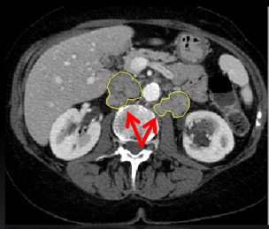
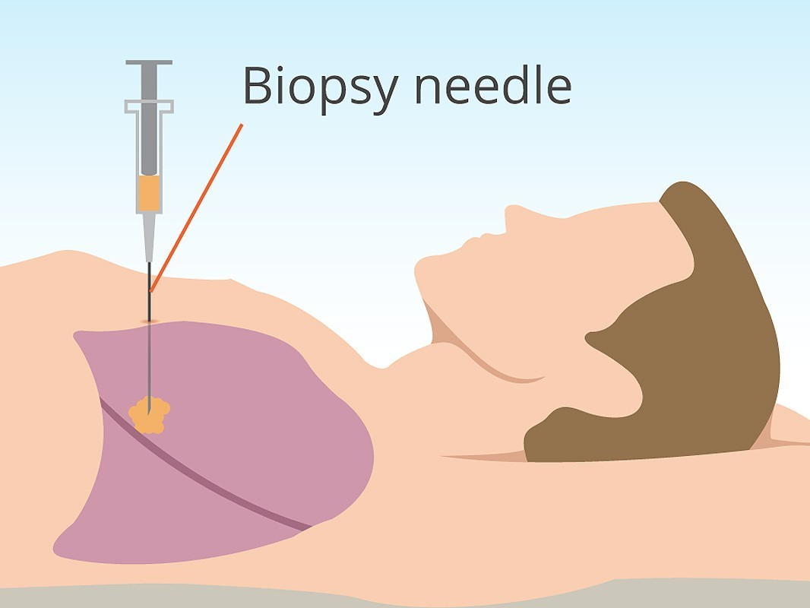
How do we detect cancer?
Can we utilize routine blood samples to detect cancer?

Slide 3

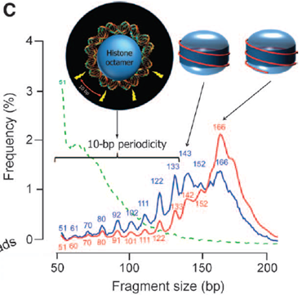
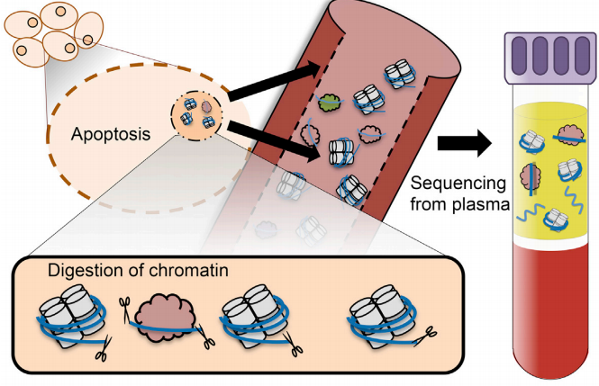
What can be detected in circulation?

Slide 4

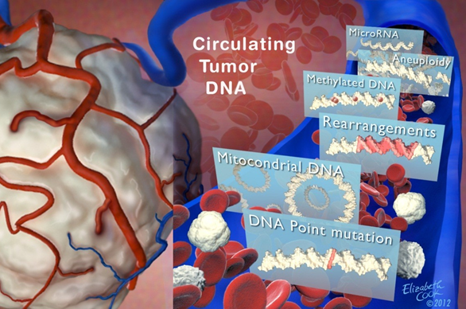
What can we measure about ctDNA?
Presence or absence of ctDNA
Quantification of ctDNA over time
Genotype of ctDNA
Changes of ctDNA genotype over time

Slide 5
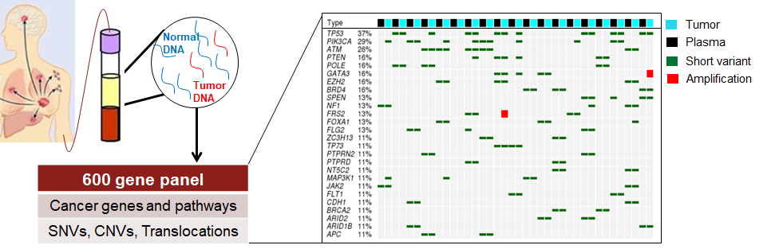
Where is Novartis looking today?
What can we learn beyond mutations?

Slide 6
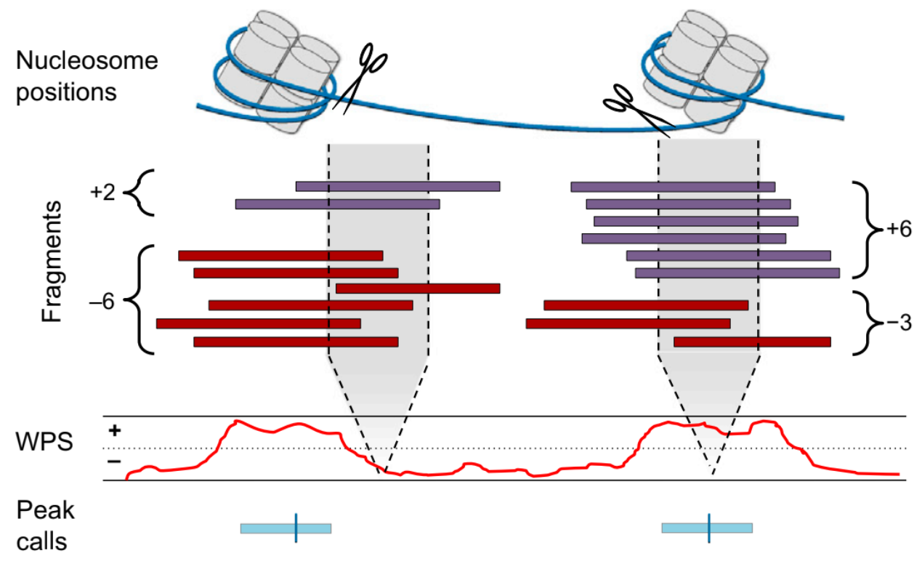
Once upon a time...
Window Protection Score (WPS)
What data is important?
What resolution is important?
How do we make this ML ready?

Slide 7
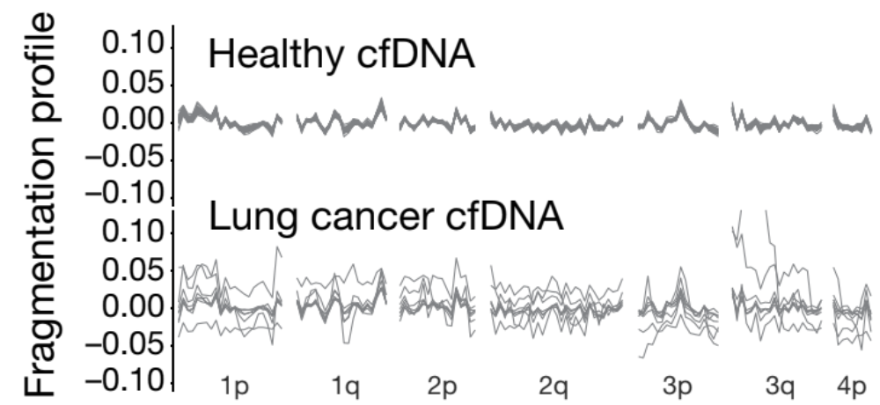
Thinking of WPS as a wave
Cristiano et al: Nature 2019
Now we can calculate features such as;
Mean, Variance, Amplitude, Power, Peak Frequency

Slide 8
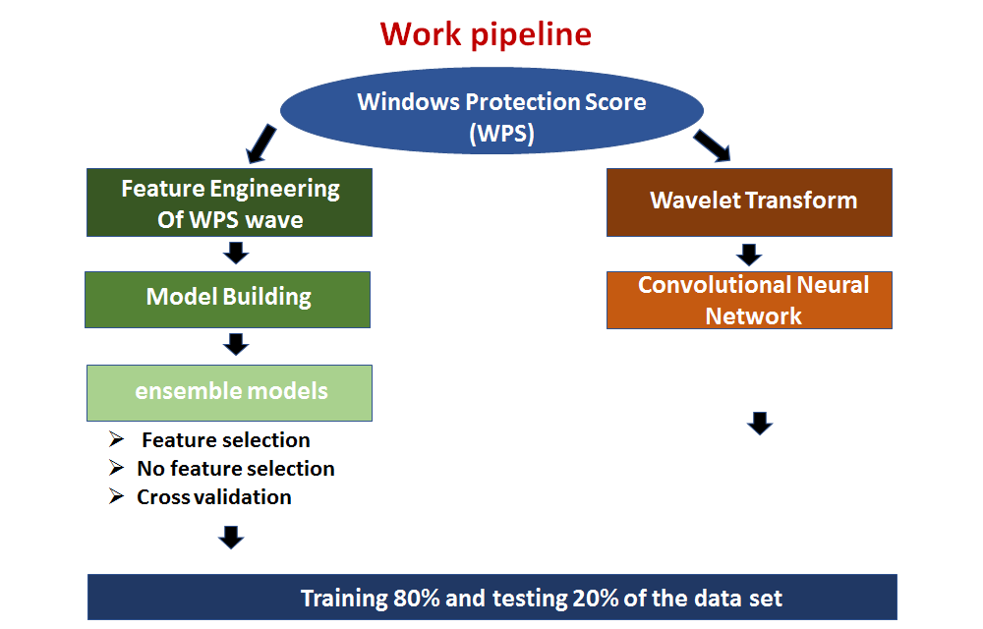
The journey

Slide 9
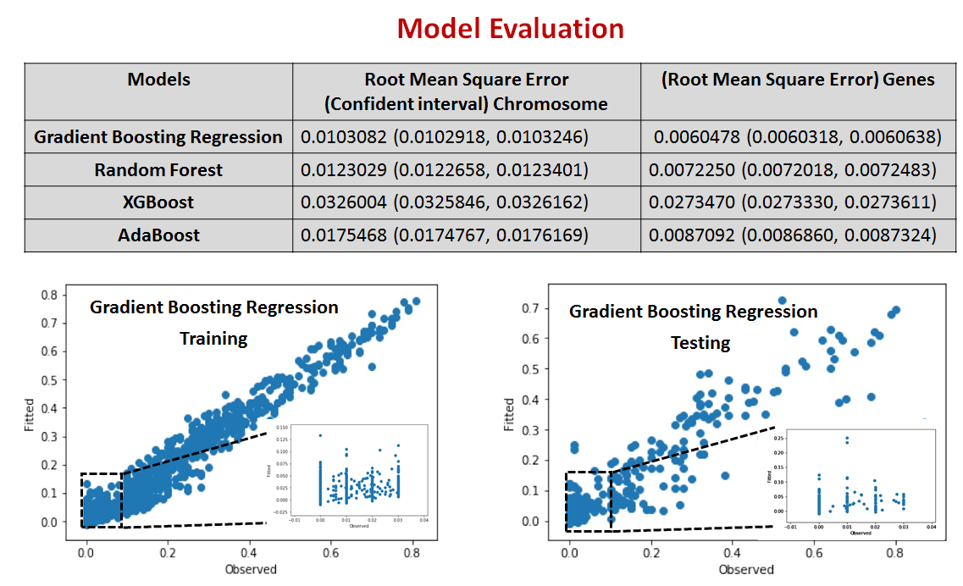
Machine Learning Approach (1)

Slide 10
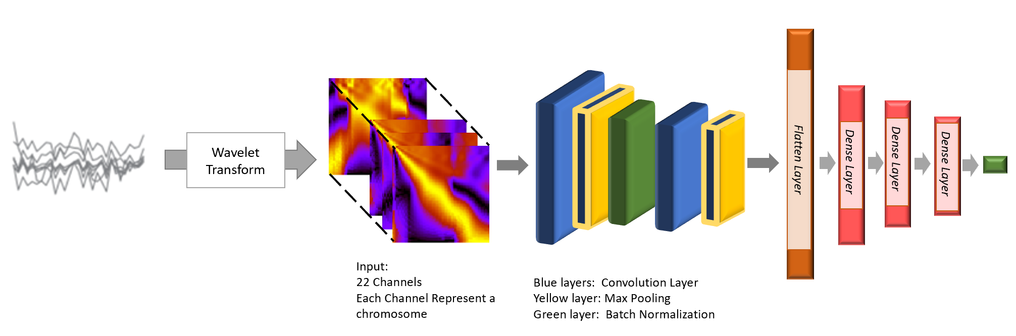
Deep Learning Approach (2)
Model | Root Mean Square Error
Convolutional Neural Network (CNN) | 0.0077846

Slide 11
Most easily interpreted results
Model | Concordant | Acceptable | Unacceptable | Percent Performance
Chromosome Level Random Forest Training | 47 | 26 | 22 | 76.8
Chromosome Level Random Forest Testing | 4 | 11 | 6 | 71.4
Combined Gradient Boosting Regression Training | 57 | 23 | 15 | 84.2
Combined Gradient Boosting Regression Testing | 7 | 8 | 6 | 71.4
Combined Random Forest Training | 53 | 23 | 19 | 80
Combined Random Forest Testing | 9 | 6 | 6 | 71.4
Chromosome Level CNN Training | 67 | 14 | 2 | 97.6
Chromosome Level CNN Testing | 9 | 6 | 4 | 78.9

Slide 12
Future directions
More features can be produced from WPS.
Study other variables in conjunction with WPS.
WPS might not sufficiently capture fragment information.
Improve machine learning performance by tuning model parameters (hyperparameter optimization).
Apply transfer learning models such as VGG16 or Inception model to improve deep learning model performance.

Slide 14
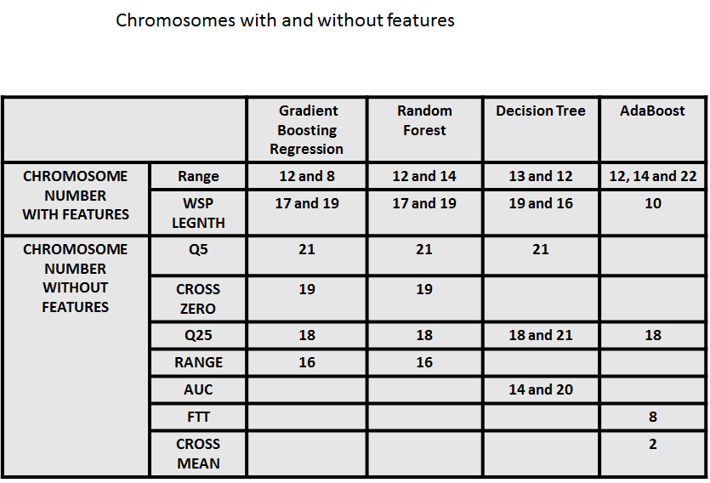
In case of questions, please break

Slide 15
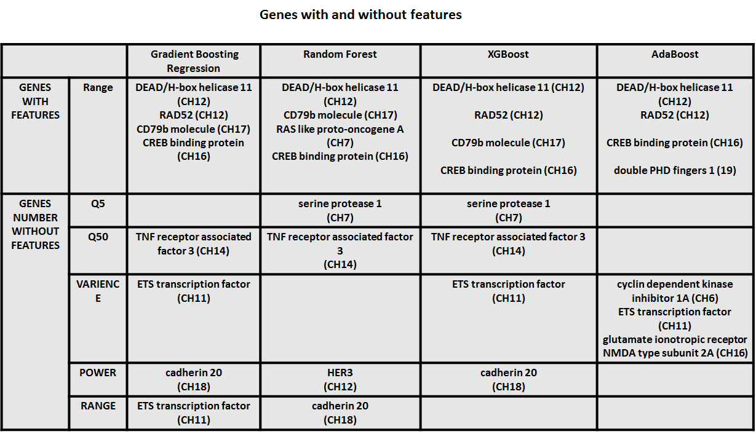

Slide 16
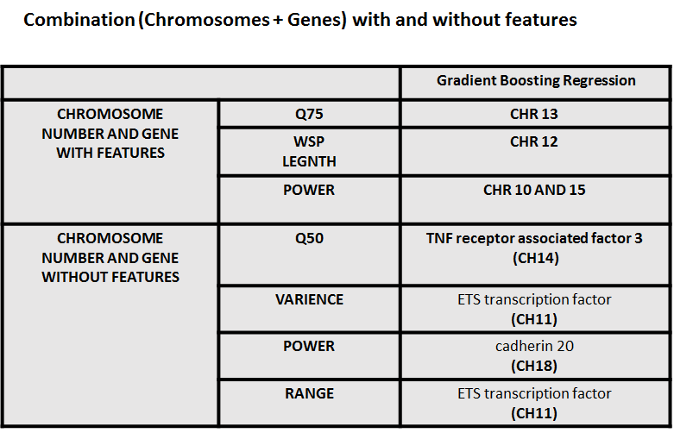

Slide 17
Ensemble Models | Key Features
Gradient Boosting Regression | Boosting: Regression Tree is fit on the negative gradient of the given loss function
Random Forest | Bagging ensemble
XGBoost | Bagging: Regression tree (weak learner)
AdaBoost | Boosting: more weight is given to the models with better performance on training data.

Slide 18
